Slide 1
Deep learning based facial emotion recognition
BATCH - 1
BATCH MEMBERS:
211FA18108 – M.BHAVYA SRI
211FA18109 – T.SAI RAMYA
211FA18103 – K.ROHITHA
GUIDE: Dr. Jyostna Devi Bodapati

Slide 2
Outline
Problem Statement
Applications
Motivation
Literature Survey
Proposed Methodology
Evaluation Metrics
Tools and Platforms
Output
References

Slide 3
PROBLEM STATEMENT
Problem: Finding the emotions of a person using facial expressions with better accuracy than existing models
Focus: Analysing emotions through images, especially facial expressions.
Integrate diverse modalities: Facial expressions, speech, and physiology.
Objective: To enhance emotional understanding based on visuals .
Challenge: Extend the approach for holistic emotion recognition.

Slide 4
Applications
Emotion recognition is widely used in many applications like:
Human-Computer Interaction
Child monitoring systems
Market Research
Security and Surveillance
Healthcare
Education and Training
Emotionally Intelligent Robots

Slide 5
Motivation
The motivation is to revolutionize by understanding and accurately identifying emotions in various domains, particularly within organizations. Facial emotion recognition at work provides crucial insights into how emotions impact daily activities, decisions, and teamwork, aiding in gauging employee engagement, stress levels, job satisfaction, and identifying potential burnout signs. Current emotion recognition systems face accuracy challenges, driving us to develop a precise, advanced model. The aim is to enhance user experiences and advance the field of emotion recognition.
Reference :
https://scroll.in/article/1054831/what-if-employers-could-gauge-the-moods-of-workers-a-dangerous-new-tech-gains-ground-in-india

Slide 6
S. No | Literature Review | Methods Used | Evaluation Metrics | Dataset | Comments
1 | Hybrid Facial Expression Recognition (FER2013) Model for Real-Time Emotion Classification and Prediction | Combination of Deep Convolutional Neural Network (DCNN) and Haar Cascade deep learning architectures | Accuracy-70.04% | FER-2013 | Challenges faced by the Paper are Overfitting, Reduced Generality of Real-time Predictions.
2 | Facial emotion recognition using deep learning: review and insights | Profound neural networks like CNNs and CNN-LSTM are used | 96.76% 95.23% 65% | CK+ JAFFE FER2013 | Intra-class variability, Inter-class similarity, Illumination variations.
3 | Facial Emotion Recognition: State of the Art performance on FER2013 | Used VGG Net architecture | 73.28% | FER-2013 | Lack of Proper Emotion Labels, Different Image Properties, Computationally Consuming Algorithms, Mis-prediction of Emotions.
4 | FERNet: A Deep CNN Architecture for Facial Expression Recognition in the Wild | Used FERNet model | 69.57% | FER-2013 | Ambiguity in Expression, Hybrid Models
5 | Facial Emotion Recognition Using Deep Convolutional Neural Network | Created a Deep Convolutional Neural Network (DCNN) model for recognizing five different human facial emotions. | 78.04% | Manually collected using a 48 MP camera. | Lighting Conditions, Complexity of Emotions
6 | A Deep Learning Framework with Cross Pooled Soft Attention for Facial Expression Recognition | Preprocessing raw images using Viola-Jones for facial detection and used extraction using a pre-trained ConvNet (Xception) | 97.67 97.46% | JAFFE CK+ | Limited improvement with deeper networks
7 | Extended deep neural network for facial emotion recognition | Deep Convolutional Neural Networks (DNNs), which integrate convolution layers and deep residual blocks | 95.23 93.24 | JAFFE CK+ | Overfitting, Hybrid Models

Slide 7
8 | Facial emotion recognition techniques: A state-of-the-art | Computer vision technique and Convolutional Neural Network | Classical approach-90 Neural network approach-86 | Jaffe CK CK+ FER 2013 MMI | Model Architecture, Salient Region Detection
9 | CC-CNN: A cross connected convolutional neural network using feature level fusion for facial expression recognition | CC-CNN model contains two levels of input for extracting the features | 97.73 93.46 85.95 71.16 | CK+ MUG RAF FER2013 FERG | Realistic Expressions, Low Image Resolution, Overfitting with Complex CNN Models, Difficulty in Feature Extraction
10 | Convolutional Features-Based Broad Learning with LSTM for Multidimensional Facial Emotion Recognition in Human–Robot Interaction | Convolution and pooling layers, broad learning (BL), and long- and short-term memory network | 92.63 82.37 47.08 | CK+ MMI SFEW2.0 | Computational Efficiency, Overfitting and Generalization, Integration of Diverse Networks
11 | Multi-Modal CNN Features Fusion for Emotion Recognition: A Modified Xception Mode | Novel multimodal methodology based on deep learning | 79.81 | M-LFW-F CREMA-D | The paper compares its method with previous approaches, but it does not provide a comprehensive analysis of the limitations and challenges of those methods.
12 | Facial expression recognition based on deep learning | AlexNet-Emotion model, DeepId, DeepId2, DeepId2+, and DeepFace | 93.5 67.4 | CK+ MMI | Insufficient training data, Interference from unrelated variables
13 | A-MobileNet: An approach of facial expression recognition | includes LBP, LBP-TOP, nonnegative matrix factorization (NMF), and sparse learning. These methods involve hand-designed features and have been used in FER competitions such as FER2013 and EmotiW | 88.11 84.49 | FERPlus RAF-DB | Complexity of the network, Hardware requirements
14 | Deep cross-domain transfer for emotion recognition via joint learning | Deep Convolutional Neural Networks (DNNs), which integrate convolution layers and deep residual blocks | 94.2 66.5 81.6 | eNTERFACE, SAVEE, EMO-DB, RAVDESS | Weak Generalization under Mismatched Conditions, Semantic Gap in Cross-Domain Transfer

Slide 8
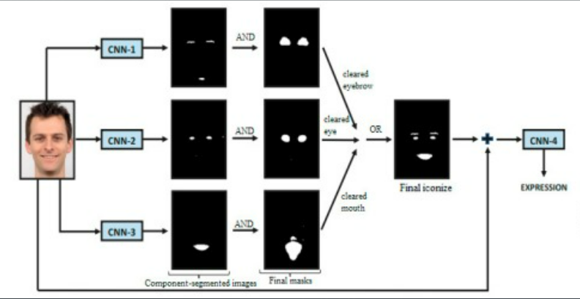
Literature survey
Title : “Facial emotion recognition using deep learning: review and insights” [1]
They used profound neural networks like CNNs and LSTMs, has significantly improved FER performance.
Researchers have proposed various deep-learning architectures for FER, including CNNs and CNN-LSTM combinations.
Various architectures achieve high accuracy in FER, with rates often exceeding 90%.

Slide 9
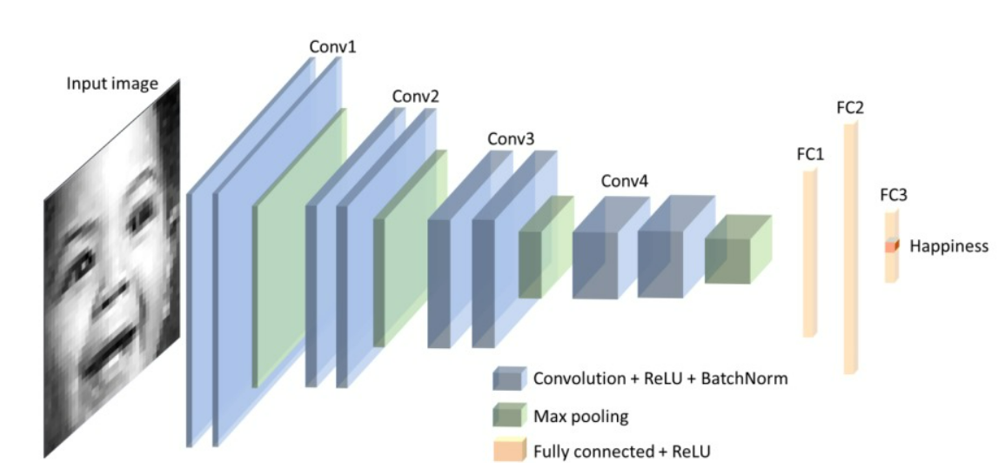
LITERATURE SURVEY Continued..
Title: “Facial Emotion Recognition: State of the Art Performance on FER2013” [3]
Highlights data augmentation for handling expression variations.
Used VGG Net architecture with convolutional and fully connected layers.
The best initial testing classification accuracy achieved is 73.06%.
Using tuning and optimization techniques, the final model achieves an accuracy of 73.28%.

Slide 10
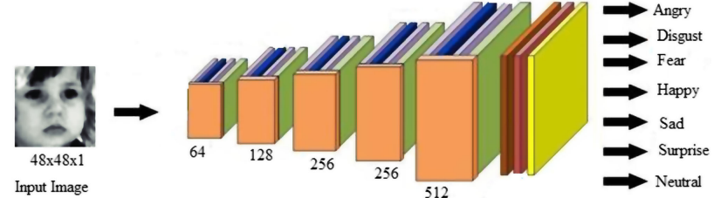
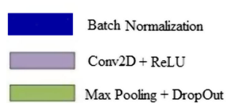
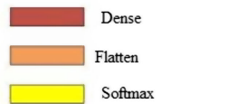
LITERATURE SURVEY Continued..
Title: “FERNet: A Deep CNN Architecture for Facial Expression Recognition in the Wild” [5]
Traditional FER methods using manual feature extraction techniques like SVM with HOG(Histogram of Oriented Gradients) and LBP(Local Binary Patterns) have limitations, especially in uncontrolled environments and complex datasets like FER 2013.
The FERNet model includes data preprocessing steps, resizing, data augmentation, and normalization. It features five convolution blocks with ReLU activation and a softmax output layer, Adam optimization, Categorical cross-entropy loss, a fixed learning rate, weight decay, dropout, and Xavier weight initialization, with specified kernel sizes and max-pooling windows.
FERNet achieved an accuracy of around 69.57%, surpassing human accuracy on the dataset.

Slide 11
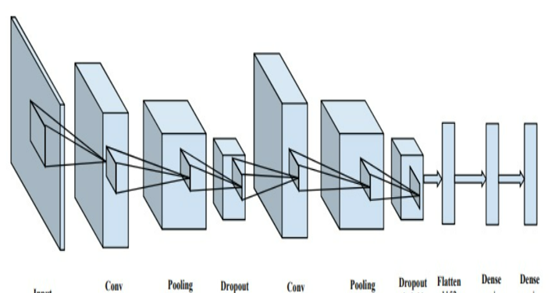
LITERATURE SURVEY Continued..
Title : “Facial Emotion Recognition Using Deep Convolutional Neural Network” [2]
The paper aims to create a Deep Convolutional Neural Network (DCNN) model for recognizing five different human facial emotions.
The proposed DCNN model utilizes a two-layer architecture with convolution, pooling, dropout, and fully connected layers.
The input images are resized to 32x32 and passed through ReLU activation functions.
The model is trained using a dataset manually collected using a 48 MP camera.
The model achieves an accuracy of 78.04%, showing that it can reasonably classify emotions.

Slide 12
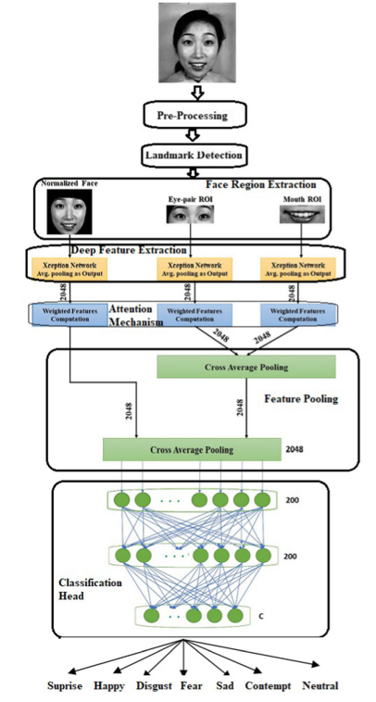
LITERATURE SURVEY Continued..
Title: “A Deep Learning Framework with Cross Pooled Soft Attention for Facial Expression Recognition” [4]
The proposed attention-based model is tested on popular datasets, JAFFE and CK+, demonstrating superior results compared to traditional models.
The paper outlines the proposed model's pipeline, which involves preprocessing raw images using Viola-Jones for facial detection, followed by feature extraction using a pre-trained ConvNet (Xception) on regions of interest (eye-pair and mouth). This process yields feature descriptors for expression recognition.
The proposed model gives an accuracy of 97.67 and 97.46% on JAFFE and CK+ datasets, respectively.

Slide 13
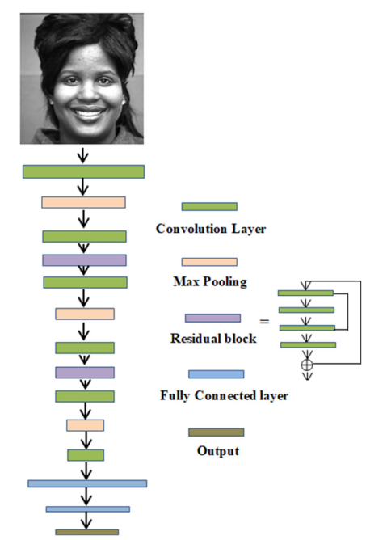
LITERATURE SURVEY Continued..
Title: “Extended deep neural network for facial emotion recognition” [6]
The model is trained on two datasets: Extended Cohn–Kanade (CK+) and Japanese Female Facial Expression (JAFFE) Dataset.
The model's foundation rests upon a singular architecture, the Deep Convolutional Neural Networks (DNNs), which integrate convolution layers and deep residual blocks.
The model's workflow involves two primary steps: initially, assigning image labels to all faces during training, followed by the passage of images through the designed DNN model.
The accuracy of the proposed model is 95.23% and 93.24% on JAFFE and CK+ respectively.

Slide 14
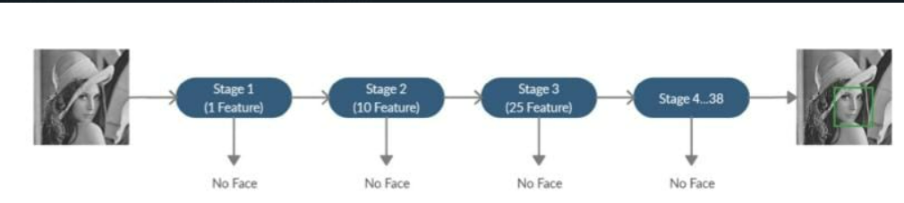
LITERATURE SURVEY Continued..
Title: “facial emotion recognition techniques: A state-of-the-art” [7]
The model is trained on five datasets: Jaffe, CK, CK+, FER 2013, and MMI.
There are two approaches: Classical and Neural network approaches.
The classical approach typically involves computer vision technique and the Neural network approach involves Convolutional Neural Network (CNN)
For these five datasets, the Classical approach accuracy is more than the Neural network approach. It is approximately 90%.
Where as Neural network based accuracy is about 86%.

Slide 15
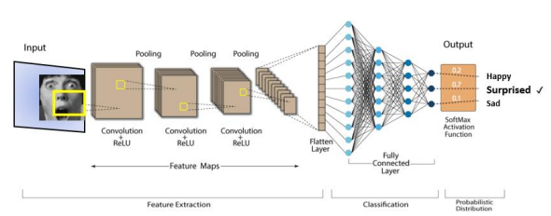
LITERATURE SURVEY Continued..
Title: “Hybrid Facial Expression Recognition (FER2013) Model for Real-Time Emotion Classification and Prediction” [8]
The paper proposes a hybrid model for Facial Expression Recognition (FER) that combines Deep Convolutional Neural Networks (DCNN) and Haar Cascade deep learning architectures
The DCNN in the model has multiple convolutional layers and ReLU activation functions to extract facial features effectively. Haar Cascade is used for real-time facial feature detection.
The results show significantly improved classification performance compared to previous experiments, achieving up to 70% accuracy with faster execution time.
the proposed model shows improved classification performance, it may not achieve optimal accuracy in all scenarios.

Slide 16
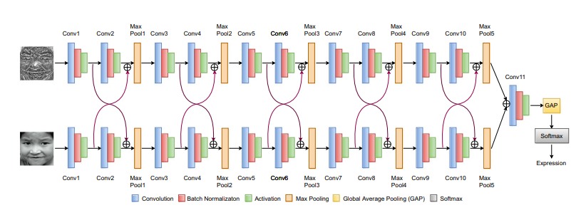
LITERATURE SURVEY Continued..
Title: “CC-CNN: A cross connected convolutional neural network using feature level fusion for facial expression recognition” [9]
This paper proposes a cross connected convolution neural network using feature level fusion for facial expression recognition.
The proposed CC-CNN model contains two levels of input for extracting the features related to facial expressions. Cyclopentane Feature Descriptor (CyFD), inspired by cyclopentane’s structure, has been proposed to extract significant features.
This method is applied on benchmark datasets such as CK+, MUG, RAF, FER2013 and FERG.
This method gives an accuracy of 97.73 on CK+,71.16 on FER2013 ,93.46 on MUG,85.95 on RAG.
The proposed CC-CNN can help recognize happy, disgusted, and sad expressions. The proposed model may not accurately recognize anger, fear, and surprise facial expressions.
The model doesn’t give accurate results for low-resolution images and occluded images.

Slide 17
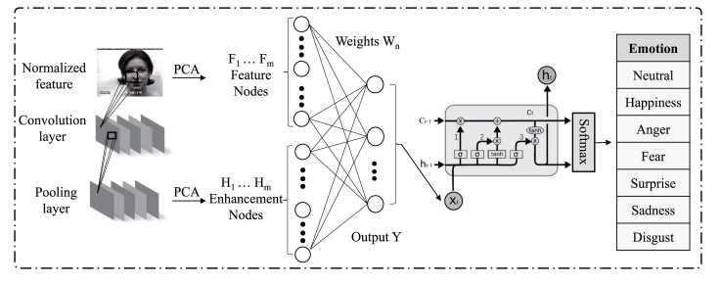
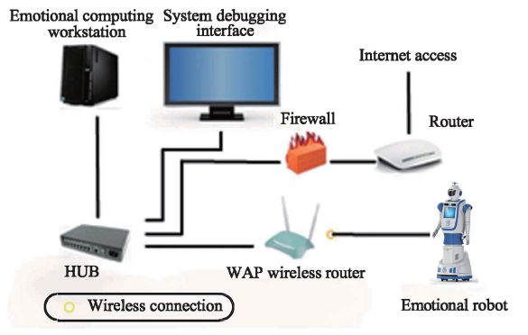
LITERATURE SURVEY Continued..
Title: “Convolutional Features-Based Broad Learning With LSTM for Multidimensional Facial Emotion Recognition in Human–Robot Interaction” [10]
This paper is proposed to recognize multidimensional facial emotions in human–robot interaction.
The CBLSTM model consists of convolution and pooling layers, broad learning (BL), and long- and short-term memory network. It aims to obtain the depth, width, and time scale information of facial emotion through three parts of the model, so as to realize multidimensional facial emotion recognition.
datasets CK+, MMI, and SFEW2.0 with accuracy of 92.63% , 82.37% and 47.08% .
This model reduces the training time to a huge extent compared to other models.

Slide 18
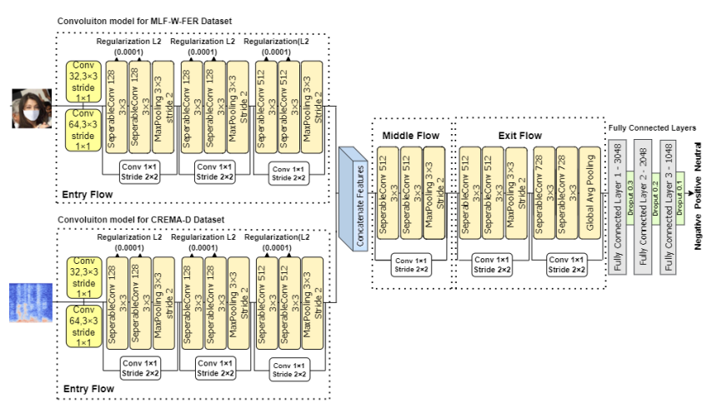
LITERATURE SURVEY Continued..
Title: “Multi-Modal CNN Features Fusion for Emotion Recognition: A Modified Xception Mode” [11]
This paper proposes a novel multimodal methodology based on deep learning to recognize facial expressions under masked conditions effectively.
The approach utilized two standard datasets, M-LFW-F and CREMA-D, to capture facial and vocal emotional expressions.
This model attained an accuracy of 79.81% surpassing the previous modelsunder masked conditions.

Slide 19
ABOUT dataset
FER-2013 Dataset:
Public dataset for facial expression recognition research.
Contains 48x48 pixel grayscale images of faces.
Each image labeled with one of seven emotions: angry, disgust, fear, happy, sad, surprise, or neutral.
Dataset Properties:
Diverse and well-labeled.
Split into training set (28,709 images), validation set (3,589 images), and test set (3,589 images).
Pre-processed version available with normalized and resized images (224x224 pixels).
Usage and Research Impact:
Widely utilized in facial expression recognition studies.
Contributed to advancements in state-of-the-art facial expression recognition techniques.
Highest Accuracy and Model:
Highest accuracy achieved: 92.50% (by PAtt-Lite model in 2023).
PAtt-Lite model: Lightweight Patch and Attention MobileNet model.
Effectively extracts crucial features from facial images.

Slide 20
Proposed methodology
There are existing machine-learning models such as:
Random Forest Classifier
KNN
SVM
Incorporating GIST features extracted from images
But there are certain disadvantages to using these models :
Imbalanced Data
Model Complexity
Limited Generalization

Slide 21
EXECUTION OF ML
Step-1 : Dataset clearing
Reoving of blank images , animies , emojis , unclearand face not visible images from FER-2013 Dataset are removed manually.
Link: https://www.kaggle.com/datasets/bhavyasri285/fer2013-cleaned-dataset
Step-2 : Feature Extraction
GIST method is used to collect required features from the images in dataset.
Step-3 : Applying various Machine Learning Algorithms
. RandomForestClassifier -> 46% accuracy obtained
. KNeighborsClassifier -> 39% accuracy obtained
. Support Vector Machine -> 43% accuracy obtained
. Support Vector Machine with polynomial kernel -> 48% accuracy obtained
Step-4 : Evaluation Metrics
Accuracy is used for finding best algorithm

Slide 22
EXECUTION OF ML Continued..
FER-2013 Dataset cleaning
GIST Feature Extraction
RandomForest Classifier
Kneighbors Classifier
Support Vector Classifier
Support Vector Machine
with polynomial kernel
Evaluation Metrics
46% accuracy
Evaluation Metrics
39% accuracy
Evaluation Metrics
43% accuracy
Evaluation Metrics
48% accuracy

Slide 23
Proposed methodology
Continued..
So Our approach involves utilizing Deep Learning models, which encompass:
Convolutional Neural Network
Leveraging pre-trained models
Implementing Transfer Learning techniques.

Slide 24
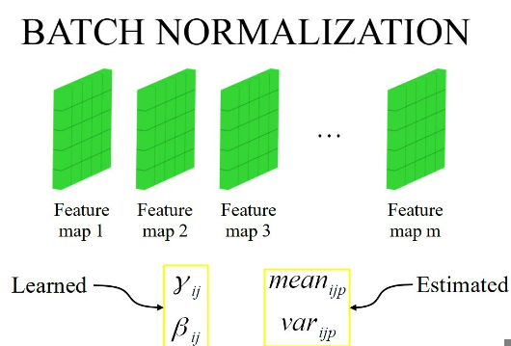
Batch normalization
Batch normalization (BatchNorm) is a technique used in deep neural networks to stabilize and accelerate training. It accomplishes this by normalizing the input values to a layer within a mini-batch of data.
Steps :
Normalization -> Centering and Scaling -> Learnable Parameters ->Applying gamma and beta -> Backpropagation
Benefits:
Faster Convergence , Regularization , Stability , Reduced Sensitivity to Initialization

Slide 25
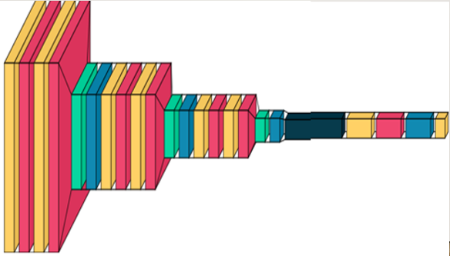



cnn
This model contains 3 Convolution blocks followed by Flatten, Fully connected and output layers.Each block consists of 2 Convolutional layers followed by batch normalization. Activation function=Relu at outputlayer=Softmax.Loss function=categorical cross-entropy. Optimizer=adam

Slide 26
Testing Accuracy w.r.t Epoches
Epochs | Accuracy
5 | 0.59
10 | 0.58
15 | 0.59
20 | 0.58
30 | 0.59
40 | 0.59
50 | 0.59
60 | 0.58
70 | 0.59
80 | 0.61
90 | 0.63
100 | 0.65

Slide 27
EVALUATION METRICS OF CNN w r t Learning Rate and Optimizers
LR | Adam |  |  |  | NAdam |  |  |  | RMSProp
 | Acc | Pre | Recall | F1 | Acc | Pre | Recall | F1 | Acc | Pre | Recall | F1
0.001 | 0.59 | 0.61 | 0.59 | 0.57 | 0.60 | 0.60 | 0.60 | 0.60 | 0.56 | 0.61 | 0.56 | 0.56
0.01 | 0.53 | 0.54 | 0.53 | 0.51 | 0.51 | 0.55 | 0.51 | 0.50 | 0.59 | 0.60 | 0.59 | 0.58
0.1 | 0.25 | 0.46 | 0.25 | 0.18 | 0.32 | 0.29 | 0.31 | 0.29 | 0.37 | 0.65 | 0.37 | 0.33
0.0001 | 0.42 | 0.38 | 0.42 | 0.38 | 0.30 | 0.28 | 0.27 | 0.28 | 0.51 | 0.50 | 0.51 | 0.50
0.00001 | 0.42 | 0.38 | 0.42 | 0.39 | 0.29 | 0.28 | 0.28 | 0.29 | 0.51 | 0.50 | 0.51 | 0.50
LR | SGD |  |  |  | AdaGrad |  |  |  | AMSGrad
0.001 | 0.42 | 0.40 | 0.42 | 0.39 | 0.51 | 0.51 | 0.51 | 0.51 | 0.631 | 0.643 | 0.631 | 0.634
0.01 | 0.42 | 0.41 | 0.42 | 0.40 | 0.51 | 0.50 | 0.51 | 0.50 | 0.640 | 0.657 | 0.640 | 0.643
0.1 | 0.41 | 0.41 | 0.41 | 0.39 | 0.51 | 0.51 | 0.51 | 0.51 | 0.476 | 0.485 | 0.476 | 0.438
0.0001 | 0.42 | 0.39 | 0.42 | 0.39 | 0.51 | 0.50 | 0.50 | 0.49 | 0.611 | 0.610 | 0.611 | 0.607
0.00001 | 0.31 | 0.29 | 0.31 | 0.28 | 0.50 | 0.49 | 0.49 | 0.49 | 0.601 | 0.590 | 0.601 | 0.598

Slide 28
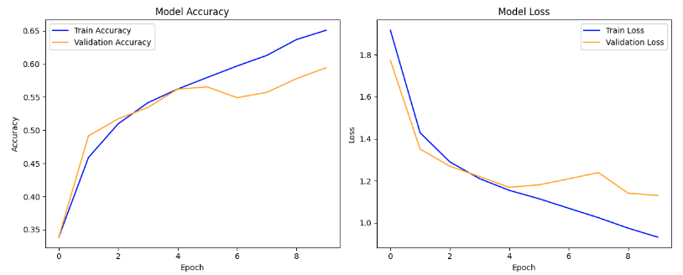
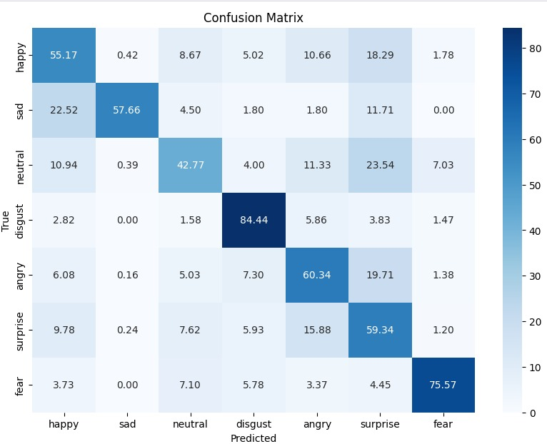
Accuracy &Loss vs Epoch
Confusion matrix

Slide 29
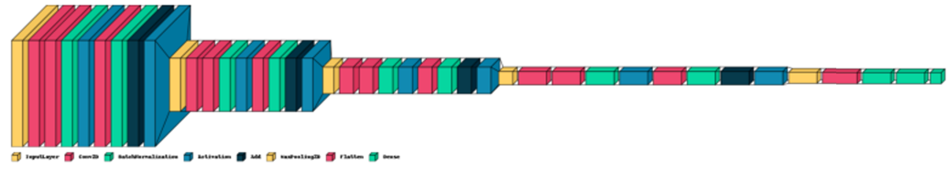
VGG-ResNet Hybrid model
In this model, we have a similar structure in the beginning with convolutional layers followed by max-pooling, reminiscent of VGG.
The residual_block function in this model closely resembles the residual blocks used in ResNet.
Hybrid Approach: By combining elements of VGG and ResNet architectures, this model adopts a hybrid approach. It leverages the strengths of both architectures: the deep layer architecture of VGG and the residual learning of ResNet. This combination aims to improve feature extraction and ease of training in a deep network.

Slide 30
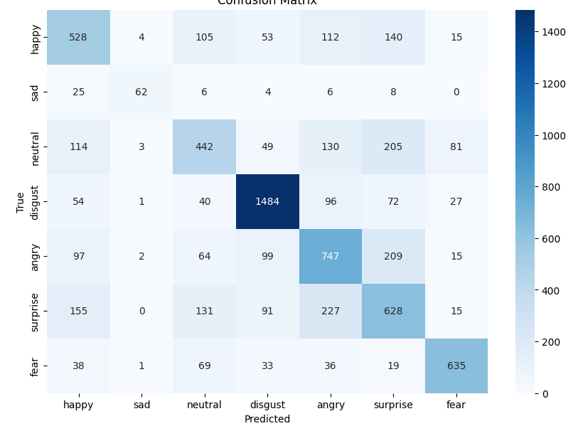
Testing Accuracy w.r.t Epoches
Confusion matrix
Epochs | Accuracy
5 | 0.59
10 | 0.58
15 | 0.59
20 | 0.58
30 | 0.59
40 | 0.59
50 | 0.59
60 | 0.58
70 | 0.59
80 | 0.60
90 | 0.61
100 | 0.63

Slide 31
EVALUATION METRICS OF VGG-ResNet Hybrid model w r t Learning Rate and Optimizers
 | Adam |  |  |  | NAdam |  |  |  | RMSProp
epoches=30 | Acc | Pre | Recall | F1 | Acc | Pre | Recall | F1 | Acc | Pre | Recall | F1
0.001 | 0.55 | 0.55 | 0.55 | 0.53 | 0.59 | 0.58 | 0.59 | 0.58 | 0.57 | 0.59 | 0.57 | 0.57
0.01 | 0.24 | 0.06 | 0.24 | 0.09 | 0.24 | 0.06 | 0.24 | 0.09 | 0.24 | 0.06 | 0.24 | 0.09
0.1 | 0.24 | 0.06 | 0.24 | 0.09 | 0.24 | 0.06 | 0.24 | 0.09 | 0.24 | 0.06 | 0.24 | 0.09
0.0001 | 0.55 | 0.56 | 0.55 | 0.51 | 0.55 | 0.57 | 0.55 | 0.54 | 0.56 | 0.64 | 0.56 | 0.55
0.00001 | 0.48 | 0.50 | 0.48 | 0.48 | 0.50 | 0.52 | 0.50 | 0.51 | 0.49 | 0.50 | 0.49 | 0.47
 | SGD |  |  |  | AdaGrad |  |  |  | AMSGrad
0.001 | 0.51 | 0.51 | 0.51 | 0.50 | 0.537 | 0.534 | 0.537 | 0.533 | 0.60 | 0.60 | 0.60 | 0.59
0.01 | 0.52 | 0.58 | 0.52 | 0.51 | 0.576 | 0.577 | 0.576 | 0.574 | 0.24 | 0.06 | 0.24 | 0.09
0.1 | 0.13 | 0.01 | 0.13 | 0.03 | 0.386 | 0.367 | 0.386 | 0.350 | 0.24 | 0.06 | 0.24 | 0.09
0.50.0001 | 0.40 | 0.38 | 0.40 | 0.38 | 0.413 | 0.386 | 0.413 | 0.388 | 0.63 | 0.63 | 0.63 | 0.62
0.00001 | 0.28 | 0.26 | 0.28 | 0.25 | 0.413 | 0.28 | 0.30 | 0.387 | 0.51 | 0.52 | 0.518 | 0.51
LR | AdamW
epoches=30 | Acc | Pre | Recall | F1 | AUC
0.001 | 0.583 | 0.615 | 0.583 | 0.591 | 0.861
0.01 | 0.558 | 0.559 | 0.558 | 0.540 | 0.843
0.1 | 0.247 | 0.061 | 0.247 | 0.097 | 0.5
0.0001 | 0.620 | 0.625 | 0.619 | 0.621 | 0.880
0.00001 | 0.619 | 0.625 | 0.619 | 0.621 | 0.881

Slide 32
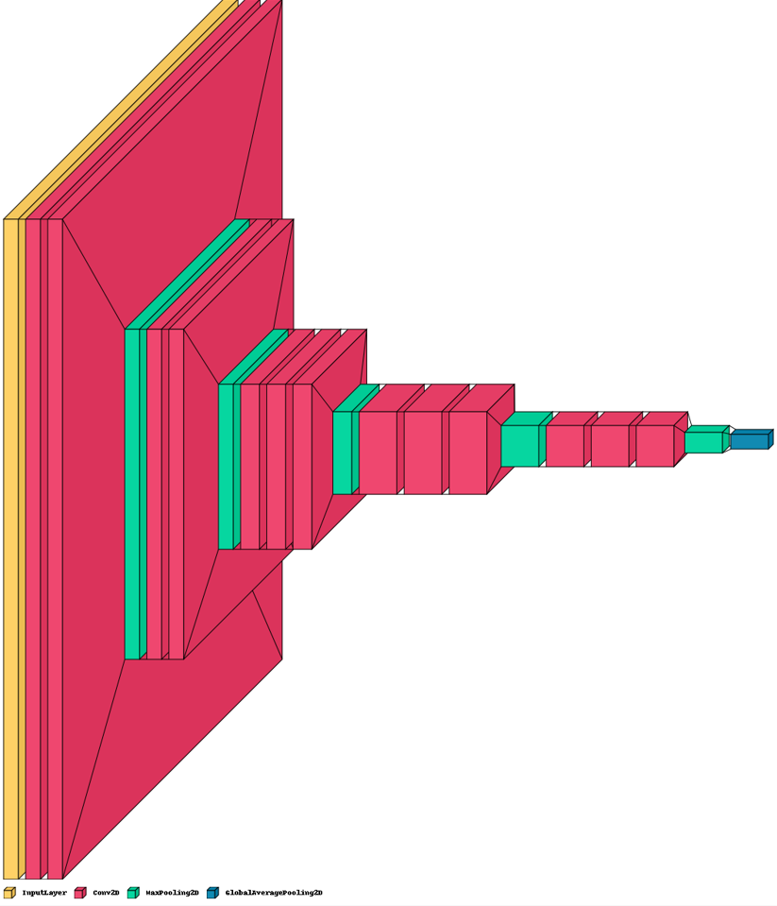
Pre-trained(VGG-16) + ml
Support Vector
Classifier
Random Forest
Classifier
Feature Extraction
Support Vector
Classifier best
Grid Search

Slide 33
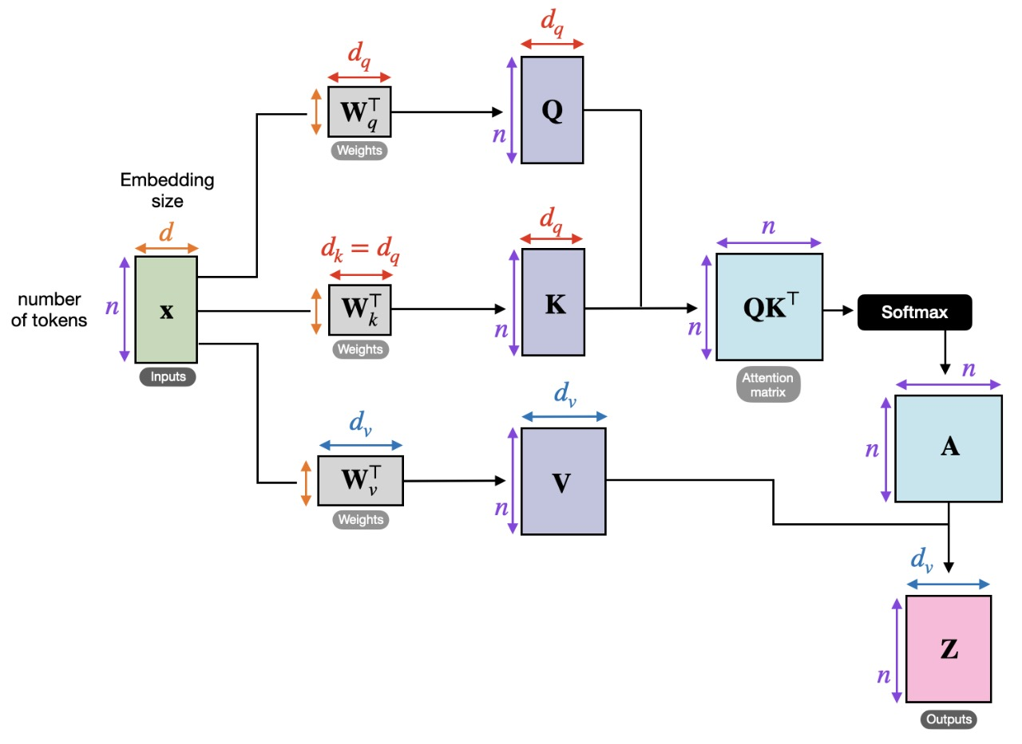

attention
The attention mechanism is part of a neural architecture that enables to dynamic highlighting of relevant features of the input data, which, in NLP, is typically a sequence of textual elements. It can be applied directly to the raw input or its higher-level representation.

Slide 34
Self-attention
Self-attention is a mechanism used in neural networks, especially in transformer architectures, to process sequences by allowing each element to consider the relationships with other elements in the sequence.
Types:
Scaled Dot-Product Attention
SoftMax attention
Multi-Head Attention
Relative Self-Attention
Hierarchial self-attention
Additive attention

Slide 35
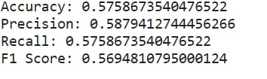


Continued…
SoftMax attention:
Hierarchial self-attention:
Additive attention:

Slide 36
Tools & platforms
Deep Learning Frameworks:
Tensor Flow
Platforms
Kaggle
Colab
Jupyter
Machine Learning Libraries:
Scikit-Learn
Keras
Data Handling and Analysis:
Pandas
NumPy
Visualization Libraries:
Matplotlib
Seaborn
VisualKeras
Hardware and Acceleration:
GPU/CPU

Slide 37

FINAL OUTPUT
Angry
Input image
Output
Model

Slide 38
references
[1] Mellouk, W., & Handouzi, W. (2020). Facial emotion recognition using deep learning: review and insights. Procedia Computer Science, 175, 689-694.
[2] Pranav, E., Kamal, S., Chandran, C. S., & Supriya, M. H. (2020, March). Facial emotion recognition using deep convolutional neural network. In 2020 6th International conference on advanced computing and communication Systems (ICACCS) (pp. 317-320). IEEE.
[3] Khaireddin, Y., & Chen, Z. (2021). Facial emotion recognition: State of the art performance on FER2013. arXiv preprint arXiv:2105.03588.
[4] Bodapati, J. D., Naik, D. B., Suvarna, B., & Naralasetti, V. (2022). A deep learning framework with cross pooled soft attention for facial expression recognition. Journal of The Institution of Engineers (India): Series B, 103(5), 1395-1405.
[5] Bodapati, J. D., Srilakshmi, U., & Veeranjaneyulu, N. (2022). FERNet: a deep CNN architecture for facial expression recognition in the wild. Journal of The institution of engineers (India): series B, 103(2), 439-448.
[6] Jain, D. K., Shamsolmoali, P., & Sehdev, P. (2019). Extended deep neural network for facial emotion recognition. Pattern Recognition Letters, 120, 69-74.
[7] Canal, F. Z., Müller, T. R., Matias, J. C., Scotton, G. G., de Sa Junior, A. R., Pozzebon, E., & Sobieranski, A. C. (2022). A survey on facial emotion recognition techniques: A state-of-the-art literature review. Information Sciences, 582, 593-617.

Slide 39
REFERENCES Continued..
[9] Kumar Tataji, K. N., Kartheek, M. N., & Prasad, M. V. (2023). CC-CNN: A cross connected convolutional neural network using feature level fusion for facial expression recognition. Multimedia Tools and Applications, 1-27.
[10] Chen, L., Li, M., Wu, M., Pedrycz, W., & Hirota, K. (2023). Convolutional Features-Based Broad Learning With LSTM for Multidimensional Facial Emotion Recognition in Human–Robot Interaction. IEEE Transactions on Systems, Man, and Cybernetics: Systems.
[11] Shahzad, H. M., Bhatti, S. M., Jaffar, A., Rashid, M., & Akram, S. (2023). Multi-Modal CNN Features Fusion for Emotion Recognition: A Modified Xception Model. IEEE Access.
[12] Ge, H., Zhu, Z., Dai, Y., Wang, B., & Wu, X. (2022). Facial expression recognition based on deep learning. Computer Methods and Programs in Biomedicine, 215, 106621.
[13] Nan, Y., Ju, J., Hua, Q., Zhang, H., & Wang, B. (2022). A-MobileNet: An approach of facial expression recognition. Alexandria Engineering Journal, 61(6), 4435-4444.
[14] Nguyen, D., Nguyen, D. T., Sridharan, S., Abdelrazek, M., Denman, S., Tran, S. N., ... & Fookes, C. (2023). Deep cross-domain transfer for emotion recognition via joint learning. Multimedia Tools and Applications, 1-18.

Slide 40
Thank you

